Slide 1
CSCI 332 TERM PROJECT-Task 2
Timia davis & christopher chism

Slide 2
Setup/Receiving/receiving
Enter user listening port
Enter buddies listening port
Enter buddies ip address
Type in keyword to cpu 1 and hit enter on cpu 2 and vice versa and enjoy!!!

Slide 3

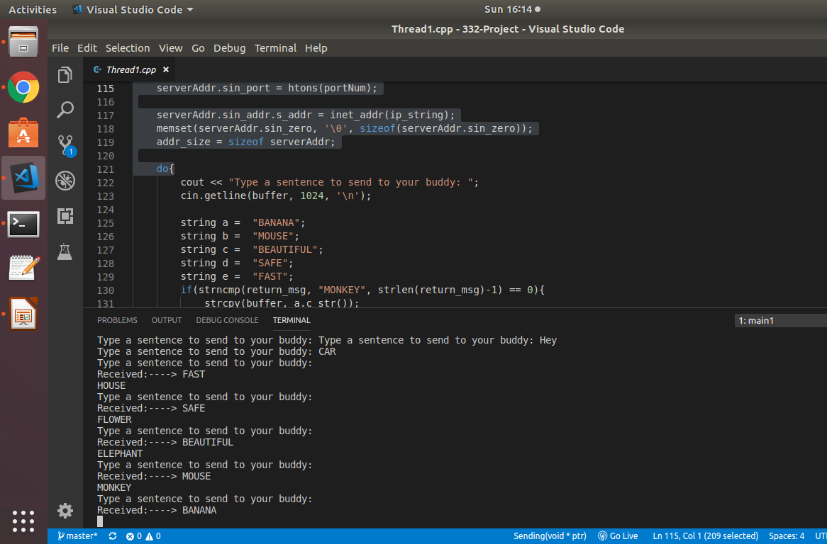
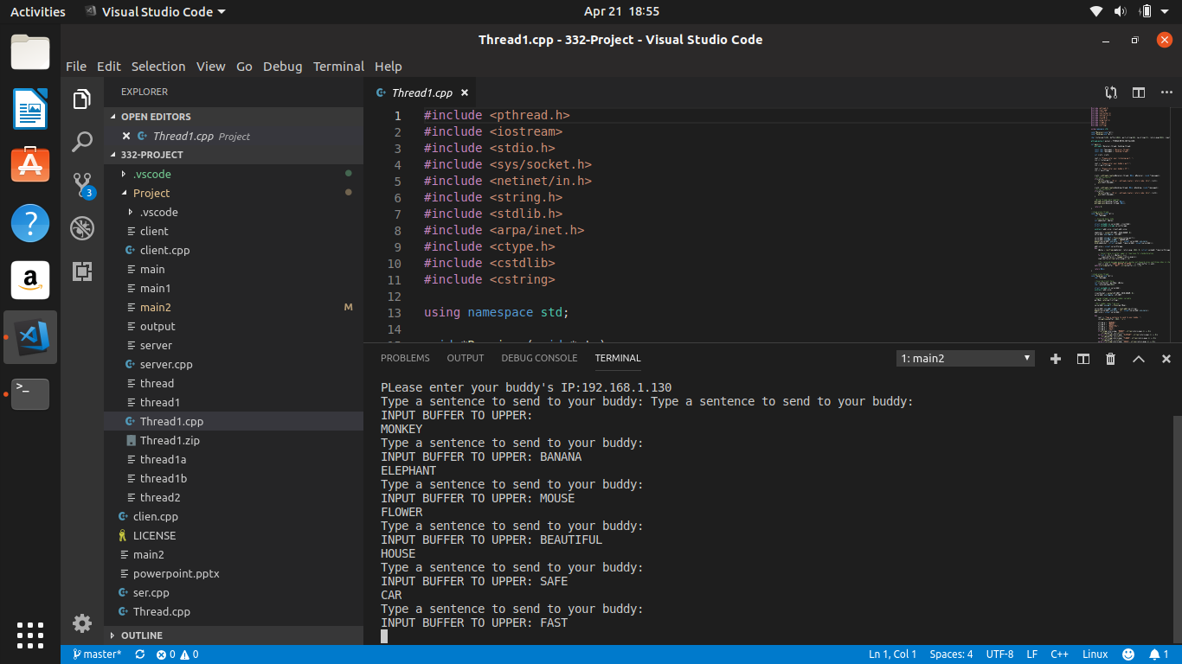

Receiving/sending

Slide 4
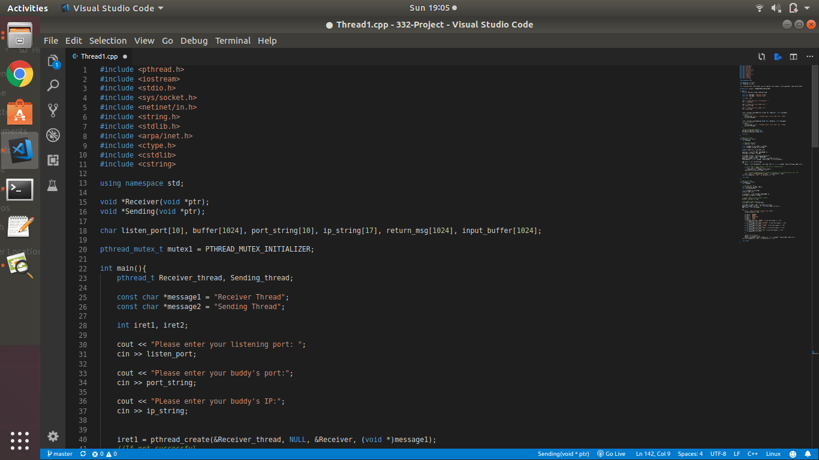
Source code

Slide 5
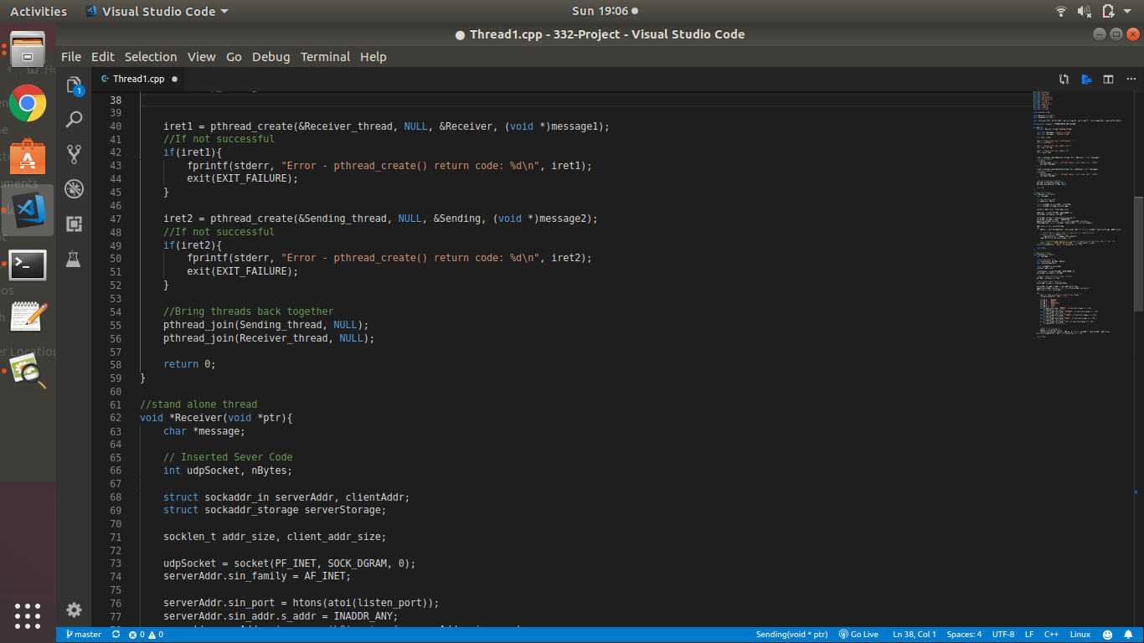
Source code

Slide 6
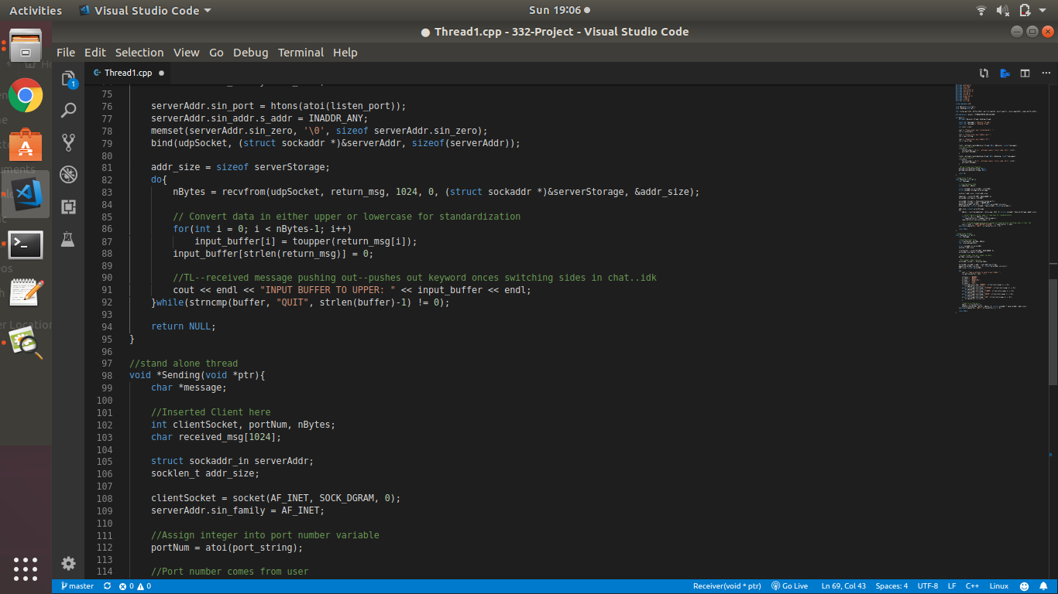
Source code

Slide 7
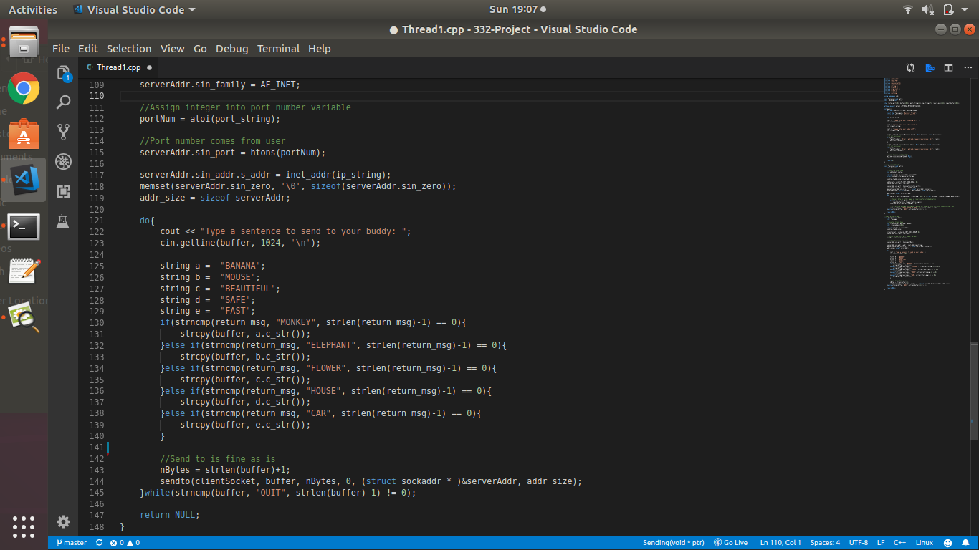
Source code

